Slide 1
South
Africa
R
F
Brazil
I
I
F
R
R
F
I
I
China
Russia
F
R
R
I
F
India

Slide 2
South
Africa
R
F
Brazil
I
I
F
R
R
F
I
I
China
Russia
F
R
R
I
F
India

Slide 3
South
Africa
R
F
Brazil
I
I
F
R
R
F
I
I
China
Russia
F
R
R
I
F
India

Slide 4
Brazil
R
F
South
Africa
I
I
Brazil
F
R
R
F
I
I
China
Russia
F
R
R
I
F
India

Slide 5
Russia
R
F
South
Africa
I
I
Brazil
F
R
R
F
I
I
China
Russia
F
R
R
I
F
India

Slide 6
India
R
F
South
Africa
I
I
Brazil
F
R
R
F
I
I
China
Russia
F
R
R
I
F
India

Slide 7
China
R
F
South
Africa
I
I
Brazil
F
R
R
F
I
I
China
Russia
F
R
R
I
F
India

Slide 8
South
Africa
R
F
South
Africa
I
Brazil
I
F
R
R
F
I
I
China
Russia
F
R
R
I
F
India

Slide 9
R
F
South
Africa
I
I
Brazil
F
R
R
F
I
I
China
Russia
F
R
R
I
F
India

Slide 11
South
Africa
R
F
Brazil
I
I
F
R
R
F
I
I
China
Russia
F
R
R
I
F
India

Slide 12
Brazil
South
Africa
R
F
Brazil
I
I
F
R
R
F
I
I
China
Russia
F
R
R
I
F
India

Slide 13
Russia
South
Africa
R
F
Brazil
I
I
F
R
R
F
I
I
China
Russia
F
R
R
I
F
India

Slide 14
India
South
Africa
R
F
Brazil
I
I
F
R
R
F
I
I
China
Russia
F
R
R
I
F
India

Slide 15
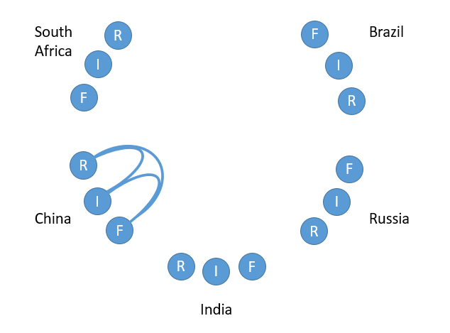
China
South
Africa
R
F
Brazil
I
I
F
R
R
F
I
I
China
Russia
F
R
R
I
F
India

Slide 16
South
Africa
R
F
Brazil
I
I
F
R
R
F
I
I
China
Russia
F
R
R
I
F
India

